Slide 1
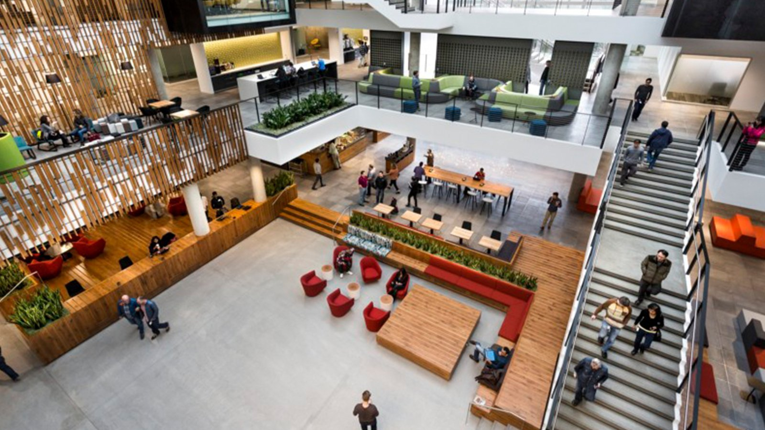

Movie Industry Market Analysis
Prepared For Microsoft By
Nick Abell, Flatiron

Slide 2
Table of Contents
Introduction
Project Goal
Questions & Assumptions
Data Sourcing & Cleaning
Visualizations & Findings
Genre
Budget & Runtime
Directors
Release Date
Recomendation

Slide 3
Introduction
Questions:
Project Goal: Analyze movie industry data and trends, and make recommendations to Microsoft for a movie profile that would maximize audience rating and total box office performance.
Which genre averages the highest worldwide profit and audience ratings since 1990?
What is the average budget and runtime of movies in this genre?
Which directors have the highest total box office and audience ratings in this genre?
Which release month averaged the highest total box office since?
Assumptions:
Only movies released since 1990 are relevant to current trends in popularity and profitability.
Microsoft wants to maximize popularity and profitability, and budget is not a limiting factor.
Audience scores are far more valuable than critic scores in predicting movie performance and reception.

Slide 4
Data Sourcing
& Cleaning
Data Sources:
IMDb = Movie titles, budgets, box office, ratings, genres, directors
Metacritic = Audience ratings
Box Office Mojo = Box office (domestic & foreign)
Data Shape:
3582 entries/movies
35 columns
Data Used for Analysis:
Movie Title
Release Date
Duration (min)
Director(s)
Genre Tags
Production Budget
Domestic & Worldwide Box Office
IMDb & Metacritic audience ratings

Slide 5

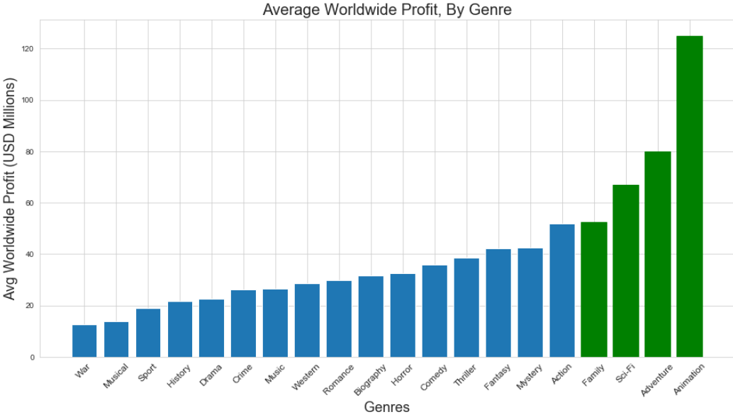
Worldwide Profit by Genre
Finding: Sci-Fi Adventure, and Animated Family movies offer the highest average profit worldwide

Slide 6
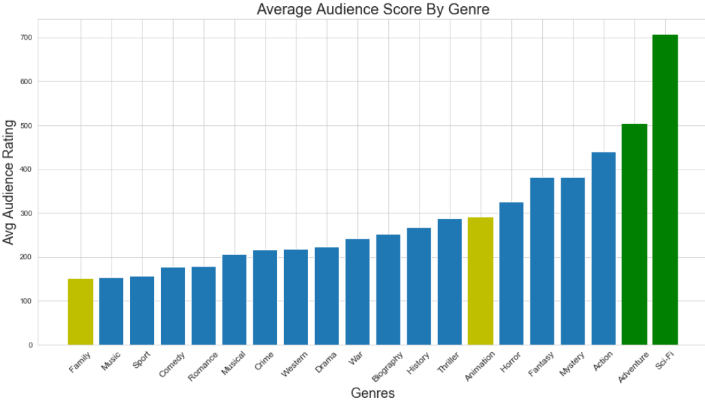
Audience Rating/Popularity by Genre
Finding: Sci-Fi Adventure movies offer the highest audience ratings
Notes:
Make plot text larger

Slide 7
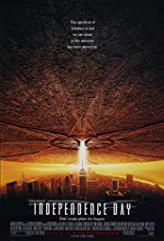



Example Sci-Fi Adventure Films
$817M
$385M
$2B
$709M

Slide 8
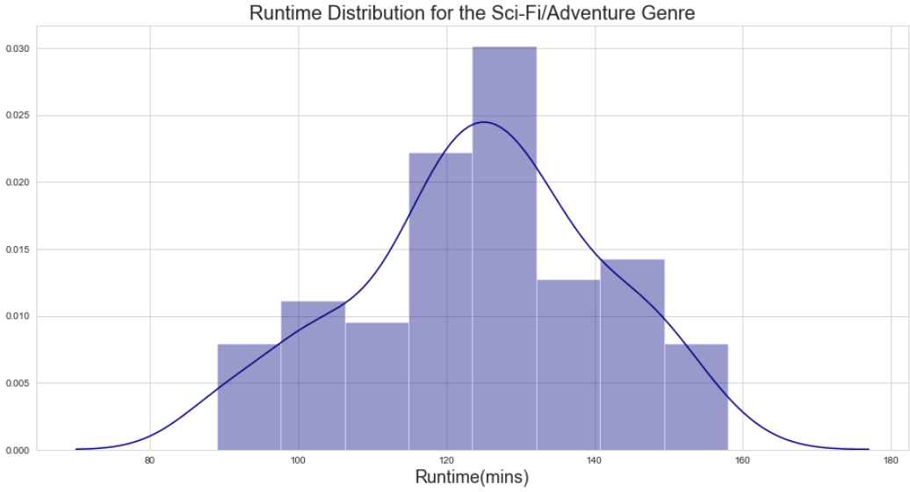
Average Sci-Fi Adventure Movie Length
Finding: Sci-Fi movies have an average runtime of 112 minutes.

Slide 9
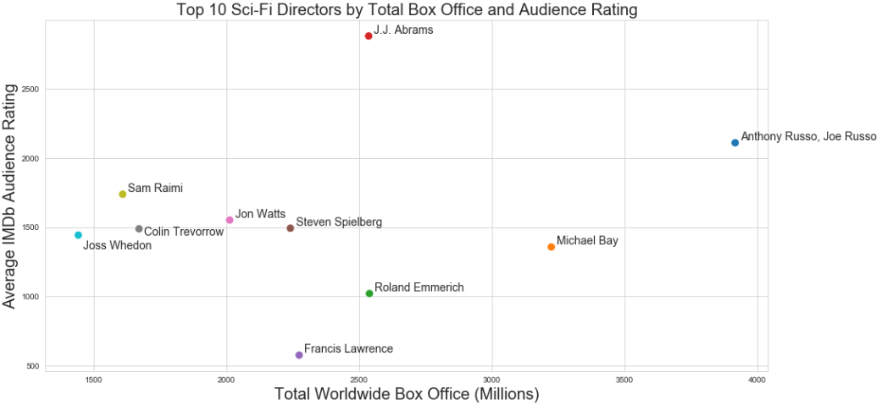
Top 10 Sci-Fi Adventure Directors
Finding: Hire The Russo Brothers, J.J. Abrams, or Michael Bay

Slide 10
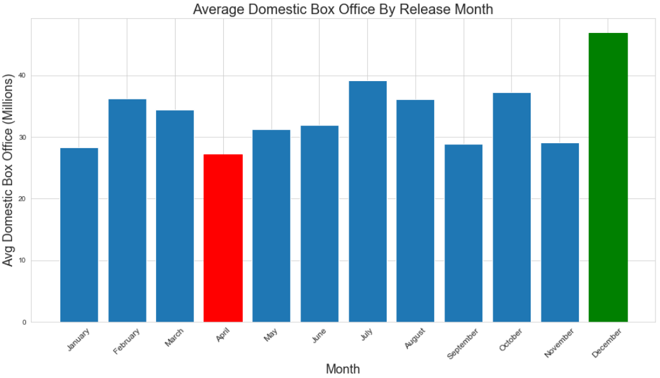
Average Domestic Box Office by Release Month
Finding: Release the movie in December or July

Slide 11
Genre: Sci-Fi / Adventure
To maximize both audience rating/popularity and profit
Recommended Movie Profile
Runtime: 120 to 130 mins
The average runtime for Sci-Fi Adventure movies is 124 mins
Directors: The Russo Brothers, J.J. Abrams, or Michael Bay
They directed Star Wars, Star Trek, Avengers, Transformers, etc…
Budget: 170m to 180m
Only looking at Sci-Fi Adventure movies from the last 10yrs
Release Month: December
To maximize total domestic box office performance

Slide 12

What Sci-Fi IP does Microsoft already own?

Slide 13

Microsoft should make
HALO – The Movie

